Slide 1


Welcome to Everybody

Slide 2

Abul kalam
Assistant teacher
Senbag Government Pilot High School.
Senbag,Noakhali.

Slide 3

Justify previous knowledge.
1.Have You Seen Your School?
2.Is it a big school?
3.Where is Your School ?
4.Is it a boys or girls school?

Slide 4
Class;Ten.
Subject:EnglishFirst Paper
Unit Three Lesson:One
Tropics: Devonport High School for girls

Slide 5

1.By the end of the lesson you will learn about a school
2. Also learn student profiles and written adescription of a school.
Notes:
LL

Slide 6
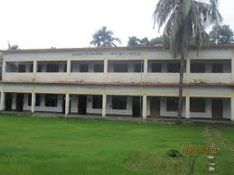
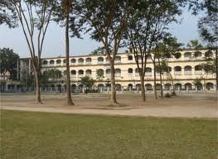
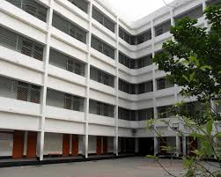
School Building

Slide 7
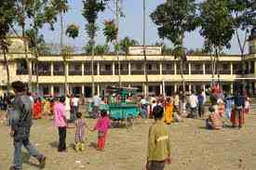
A school of Bangladesh.

Slide 8
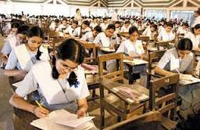

Slide 9
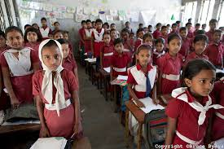
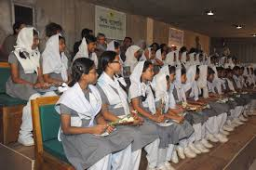
Two class room of Bangladesh.
School 1
School 2
Now What is the Difference between two School ?
School Dressup

Slide 10

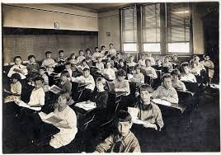
Two class room of two girls school.

Slide 11
1.what are the aims of the school?
Ans:The aims of the school is to educate girls.
2.How does the school treat the student?
Ans:The school treats the students as young adults and involve them in decisions concerning their work and school life.

Slide 12
How do you think the school authorities
Realise their aim?
Ans I Think The School Authorities realise their aim when the students involve them in decisions concerning their work and school life.
Would you like to be in a school like that?Why?
Ans Yes I Would like to be in a school like that .Because It develops our potentials.

Slide 13
Group work { First group}
1.Do You know about M.M.Chowdhury Memorial High School ?Write 5 sentences about that school.
Group—Two .
2.Give a short description Devonport girls high school.

Slide 14
Evaluation
1.What is the aim of this school ?
2.What is the students should have ?
3.What the teachers provide the students ?

Slide 15
Home Work.
1.Write a short description about your school within five sentence.

Slide 16
Thanks to all

